Slide 1




UX AUDIT REPORT
JULY 2023
High level expert review
Heuristic evaluation & user interviews

Slide 2
1. INTRODUCTION - What we did
Executive Summary
Goals and objectives
2. METHODOLOGY- Process and Methods
Nielsen's Heuristic Evaluation
Ben Shneiderman’s 'Eight Golden Rules of Interface Design
Arnold Lund's 34 Usability Maxims
Norman's Theory of Action
Web3 Design Audit Checklist Based on Web3 Design Principles by Beltran
3. FINDINGS - What we tested on
Recommendations
4. INSIGHTS AND NEXT STEPS - What we tested on
Recommendations
In this report

Slide 3

BEEFY FINANCE UX AUDIT REPORT
INTRODUCTION

Slide 4
EXECUTIVE SUMMARY
In this comprehensive UX audit, we conducted an expert review of Beefy Finance user experience based on Web3 usability guidelines and expert review checkpoints. The aim was to assess the platform's alignment with industry best practices, ensuring a seamless and user-centric experience for all users interacting with Web3 technologies.
Our review focused on evaluating critical aspects such as platform accessibility, navigation, search functionality, user education, error handling, and the integration of Web3 wallet functionalities. Through a meticulous assessment, we identified several areas that require immediate attention to enhance the overall user experience.

Slide 5
247 WEB USABILITY GUIDELINES
This review focused on evaluating critical aspects such as platform accessibility, navigation, search functionality, user education, error handling, etc. Through a meticulous assessment, we identified several areas that require immediate attention to enhance the overall user experience.
UX PRINCIPLES | COMPLIES | DOESN’T COMPLY | NOT APPLICABLE | COMPLIANCE RATE
Home Page | 13 Criteria | None | None | 100%
Task orientation | 17 Criteria | 5 Criteria | 2 Criteria | 77%
Navigation and IA | 14 Criteria | 3 Criteria | 2 Criteria | 82%
Forms and data entry: | 11 Criteria | None | 5 Criteria | 100%
Trust and credibility | 8 Criteria | None | None | 100%

Slide 6
UX PRINCIPLES | COMPLIES | DOESN’T COMPLY | NOT APPLICABLE | COMPLIANCE RATE
Writing and content quality | 16 Criteria | None | 3 Criteria | 100%
Page layout and visual design: | 30 Criteria | 2 Criteria | 2 Criteria | 93%
Search usability | 8 Criteria | 7 Criteria | 1 Criteria | 53%
Help, feedback and error tolerance | 19 Criteria | 3 Criteria | 2 Criteria | 82%
Total | 136 Criteria | 21 Criteria | 16 Criteria | 86%

Slide 7
REVIEW BASED ON WEB3 UX PRINCIPLES
By Beltran
This review focused on evaluating critical aspects involved in the integration of Web3 wallet functionalities.
UX PRINCIPLES | COMPLIES | DOESN’T COMPLY | NOT APPLICABLE | COMPLIANCE RATE
Transparency of Data provenance | 2 Criteria | 2 Criteria | None | 50%
Transparency of Transactions | 4 Criteria | 3 Criteria | 1 Criteria | 57%
Transparency of Smart Contract | 1 Criteria | 1 Criteria | 1 Criteria | 50%
Transparent User interaction History | None | 3 Criteria | None | 0%
Transparency of Code | 4 Criteria | 2 Criteria | 1 Criteria | 66%

Slide 8
UX PRINCIPLES | COMPLIES | DOESN’T COMPLY | NOT APPLICABLE | COMPLIANCE RATE
Human Readable Hashes Format | 3 Criteria | None | 1 Criteria | 100%
Time/Wait Management | 2 Criteria | None | None | 100%
Permanent Newbie Mode | None | 3 Criteria | None | 0%
Gas Price and Transaction Reversal | 1 Criteria | 2 Criteria | None | 33%
Sense of Community | 4 Criteria | None | None | 100%
Total | 21 Criteria | 16 Criteria | 4 Criteria | 55%

Slide 9
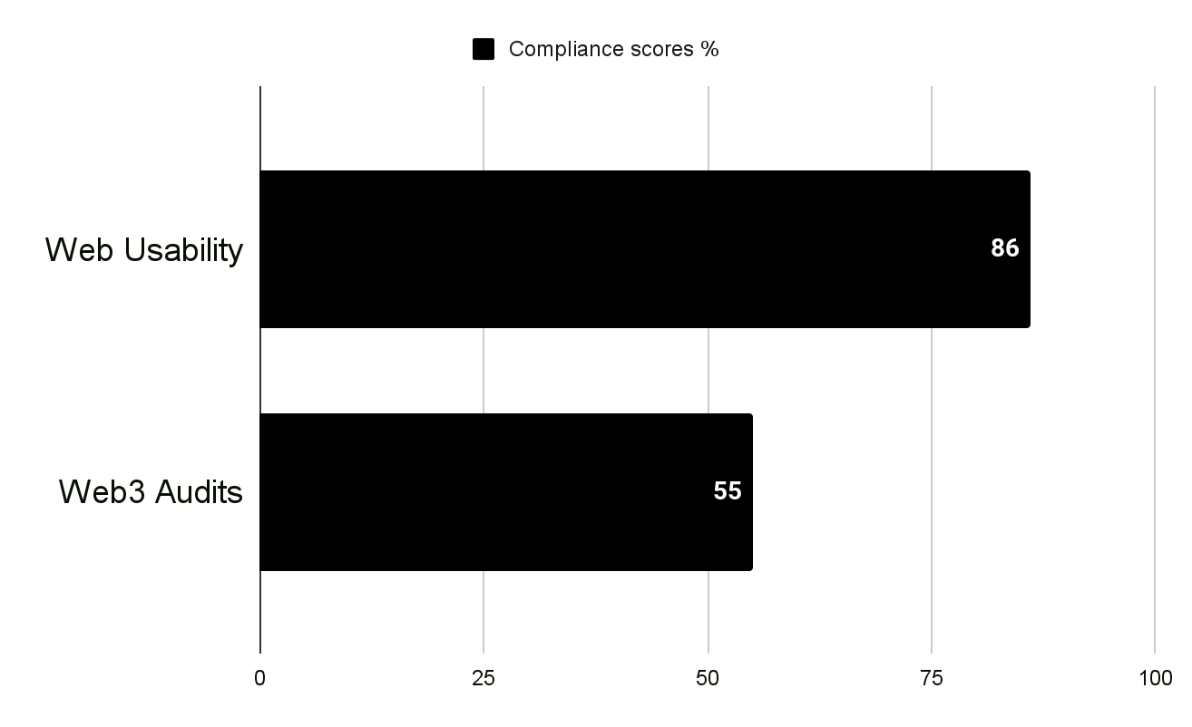
USABILITY STATS
Overall Compliance percentage
Usability Score
GOOD
80.8%
Users should be able to use this site or system with relative ease and should be able to complete the vast majority of important tasks.
Overall Compliance
Overall non compliance
156/193
37/193

Slide 10
PRODUCT OVERVIEW
Beefy is a Decentralized, Multichain Yield Optimizer that allows its users to earn compound interest on their crypto holdings. Beefy earns you the highest APYs with safety and efficiency in mind.
CONTEXT OF THE AUDIT
This study involved collecting a rich research database consisting of detailed observations and findings based on Nielsen's Heuristic Evaluation, Design Arnold Lund's 34 Usability Maxims, and Web3 Design Audit Checklist Based on Web3 Design Principles by Beltran
These valuable resources complement and support the findings presented in this report.

Slide 11
BEEFY FINANCE UX AUDIT REPORT
METHODOLOGY

Slide 12
METHODOLOGY
This report summarizes the findings of a comprehensive UX audit conducted on Beefy Finance platform.
The audit utilized a combination of renowned UX methodologies, including Nielsen's Heuristic Evaluation, Ben Shneiderman’s 'Eight Golden Rules of Interface Design, Arnold Lund's 34 Usability Maxims, Norman's Theory of Action, and the Web3 Design Audit Checklist Based on Web3 Design Principles by Beltran.
The purpose of the audit was to assess the user experience and identify areas for improvement to enhance usability and overall satisfaction

Slide 13
SEVERITY SCALE
Critical
Severely impairs the use of the product and cannot be overcome by users. It is necessary to fix this before releasing the product..
Serious
Occurs frequently and persistently, or users may not be able to resolve the issue or may not be aware of it. It's important to fix this, so give it a high priority..
Medium
May occur more often or be harder to overcome. Fixing this should be a low release priority.
Low
Can be easily overcome by the user or occurs very rarely. The release does not require repair unless additional time is available.

Slide 14
BEEFY FINANCE UX AUDIT REPORT
FINDINGS

Slide 15
BUSINESS GOALS
Maximizing Yield: Beefy Finance aims to help users maximize their yield generation by providing automated strategies that optimize the allocation of their assets across different yield farming opportunities in the DeFi ecosystem.
Simplifying User Experience: The platform aims to simplify the user experience by eliminating the need for users to manually monitor and manage their assets across multiple protocols. Beefy Finance automates the process, making it easier for users to participate in yield farming and earn passive income.
Enhancing Security: Beefy Finance focuses on ensuring the security of users' funds and assets by employing robust smart contract audits and security measures. By providing a secure and reliable platform, they aim to build trust and confidence among users in the DeFi space.
Expanding Partnerships: Beefy Finance may strive to form strategic partnerships with other DeFi protocols, liquidity providers, or projects to expand their reach and offer more diverse yield farming opportunities to their users. Collaborations and integrations can help grow their ecosystem and provide users with additional options.

Slide 16
CUSTOMER GOALS
Maximizing Yield: Beefy Finance customers are looking to maximize the returns on their cryptocurrency assets by participating in various yield farming strategies. They aim to earn passive income through automated and optimized allocation of their funds across different DeFi platforms.
Simplifying Investment Process: Customers seek a simplified investment experience in the DeFi space. Beefy Finance provides them with a user-friendly platform that automates the process of yield farming, eliminating the need for users to monitor multiple platforms, track strategies, or execute complex transactions manually.
Mitigating Risk: Customers want to mitigate the risks associated with DeFi investments. Beefy Finance aims to provide secure and audited smart contracts, reducing the likelihood of exploits or vulnerabilities.
Saving Time and Effort: Customers value time efficiency and want to avoid the complexities of actively managing their DeFi investments. Beefy Finance offers automated strategies that save customers time and effort by handling the allocation, optimization, and rebalancing of their assets across multiple yield farming opportunities.

Slide 17
FINDINGS
Heuristic Used
Select the appropriate heuristics principle that matches the usability issue you’ve identified.
Severity
From the severity scale, select the appropriate rating for the usability issue you’ve identified.
Issue and Recommendation
Describe the usability issue and spell out your recommendations for UX improvements.

Slide 18
BEEFY FINANCE UX AUDIT REPORT
TASK ORIENTATION AND SITE FUNCTIONALITY
People go to web sites to achieve particular goals, not to look around and admire the design. This means web pages needs to support customer tasks. A site is task oriented when it supports users in the effective and efficient completion of their tasks.

Slide 19
Issue (MEDIUM)
Recommendations
The platform does not present a clear and well-defined critical path that guides users through their intended tasks or workflows. Users may struggle to identify the optimal path to complete their goals, leading to confusion and inefficiency in task completion.
The platform necessitates excessive scrolling, requiring users to continuously scroll through long pages to access information or complete tasks. This results in a cumbersome user experience, as users have to spend more time and effort to find the desired content
Define and Communicate Critical Path: Identify and clearly define the critical path for users to achieve their goals within the platform. This involves mapping out the most efficient and straightforward journey, considering user objectives and tasks.
Consolidate relevant information and functionalities to reduce the need for excessive scrolling. Reorganize and prioritize content to ensure that essential information is readily accessible within the initial viewport, minimizing the cognitive load associated with scrolling long pages.

Slide 20
Issue (MEDIUM)
Recommendations
The platform does not display all the steps that need to be completed in a task. Users are left without a comprehensive overview of the entire workflow, making it difficult for them to anticipate the scope of the task and plan their actions accordingly.
The platform does not provide sufficient opportunities for users to explore different options or functionalities before committing themselves. Users may feel constrained by limited access or restricted capabilities, preventing them from fully understanding the platform's offerings or making informed decisions.
Display all the steps involved in a task, providing users with a complete overview of the workflow. Present the steps in a logical order, ensuring they are easily scannable and comprehensible. This helps users understand the entire process and the sequence of actions required to complete the task.
Provide feature previews or interactive demos that allow users to experience the core functionalities of the platform. This enables users to gain a firsthand understanding of the capabilities and benefits before making a commitment.

Slide 21
Issue (MEDIUM)
Recommendations
The platform does not provide different levels of explanation to cater to the varying needs of novice and expert users. Help and error messages may not offer sufficient guidance or may be too complex for novice users, while expert users may find them overly basic or lacking in-depth information.
Provide contextual help and error messages that offer clear and concise explanations based on the user's current context. Tailor the messaging to address the specific needs and knowledge level of the user, providing more detailed explanations for novice users and concise reminders or shortcuts for expert users.

Slide 22
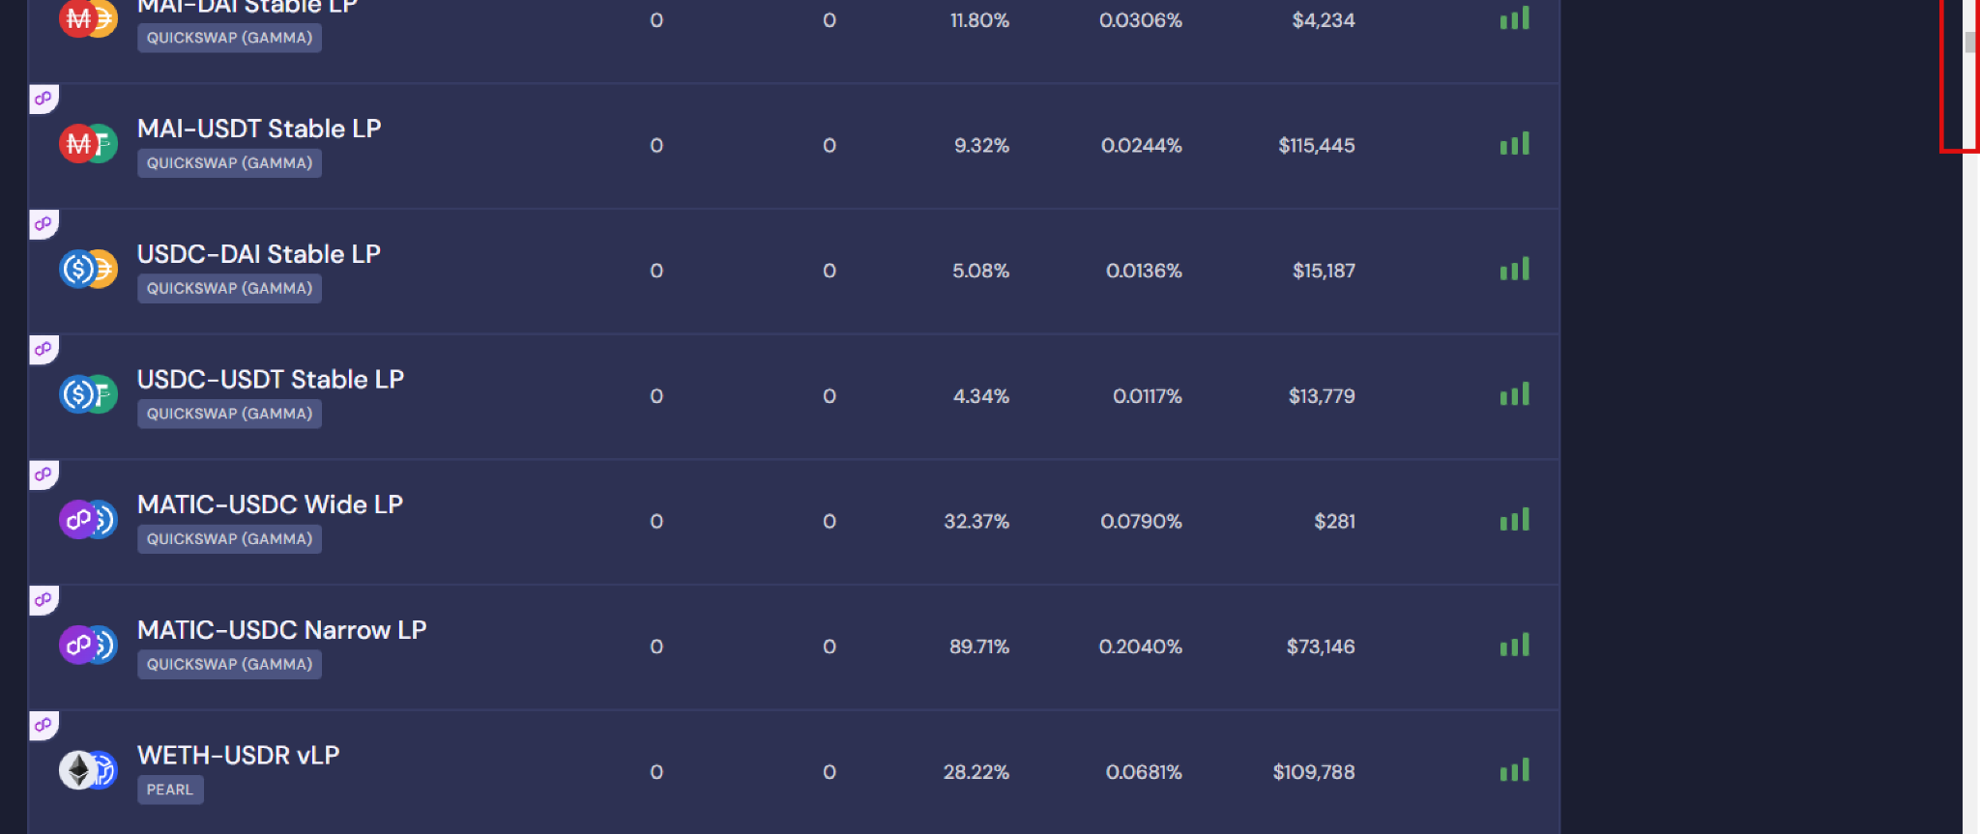
Excessive scrolling (seemingly without end) of the Vault offerings can turn off users.

Slide 23
BEEFY FINANCE UX AUDIT REPORT
NAVIGATION AND INFORMATION ARCHITECTURE
System or mechanism that allows users to move through different sections, pages, or features of a digital product. It includes menus, links, buttons, search bars, and other interactive elements that help users find and navigate to desired content or perform specific actions. Effective navigation design ensures that users can easily understand and access different areas of the product, enhancing usability and user satisfaction.
Information architecture (IA) involves the organization and structure of information within a digital product to facilitate efficient and intuitive access. It focuses on grouping and categorizing content in a logical and meaningful manner, ensuring that information is well-organized, easily discoverable, and understandable to users

Slide 24
Issue (LOW)
Recommendations
The platform's navigation tabs do not resemble clickable versions of real-world tabs. This divergence from familiar visual cues can confuse users and make it challenging for them to recognize and interact with the navigation elements. Users may struggle to differentiate between active and inactive tabs or fail to perceive them as interactive elements.
The platform does not provide adequate navigational feedback to indicate the user's current location within the site. Users are left without visual cues or indicators that help them understand their position in the site's hierarchy or navigate back to previous pages
Redesign the navigation tabs to resemble clickable versions of real-world tabs. This can include visual cues such as tab-like shapes, shadows, or indicators to convey their interactive nature
Implement clear and visible navigation indicators that show users where they are in the site's structure. This can include a breadcrumb trail, highlighted menu items, or a progress indicator that visually represents the user's current location. These indicators aid users in understanding their position and provide a sense of orientation within the platform.

Slide 25
Issue (LOW)
Recommendations
Visual Feedback: The platform does provide a visible change when the mouse hovers over some clickable elements, aside from cursor changes.
Implement consistent and noticeable hover states or visual feedback for only clickable elements

Slide 26
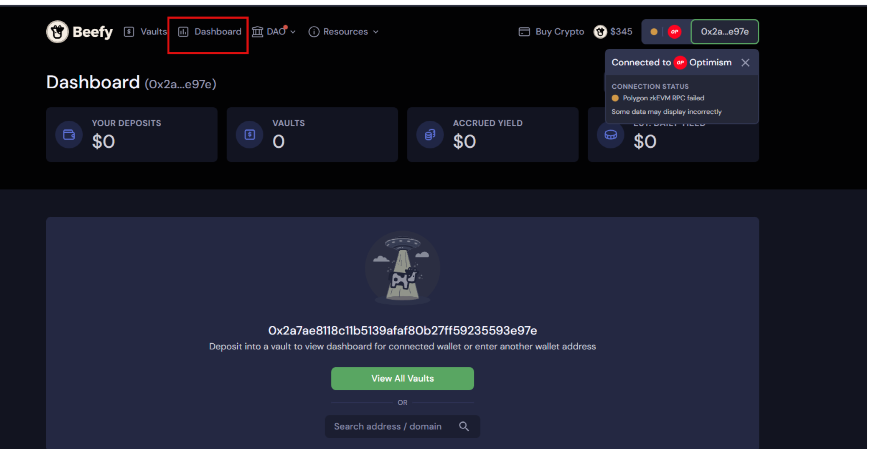
Visual Feedback: Dashboard page has no visual cues or indicators that help connected users understand their position in the site's hierarchy or navigate back to previous page.

Slide 27
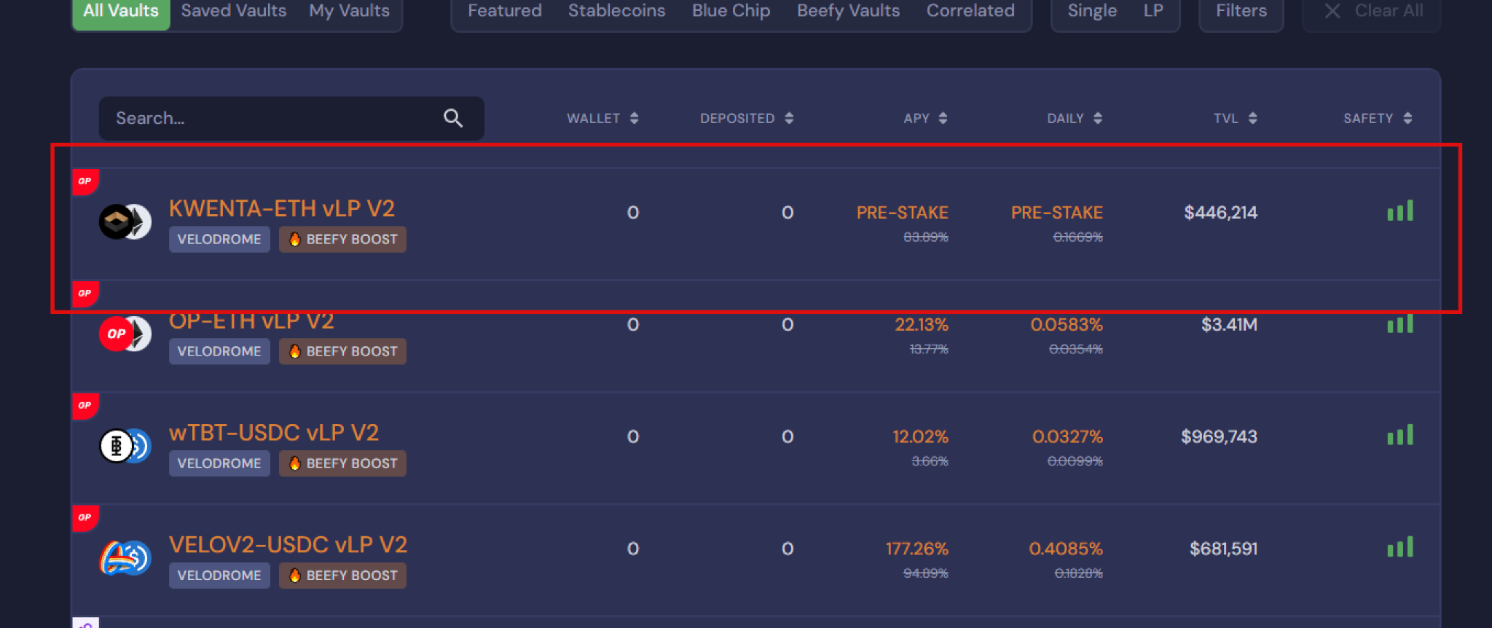
Visual Feedback: The Vault offerings which is a clickable feature does not provide a visible change on mouse hover aside from cursor changes.

Slide 28
BEEFY FINANCE UX AUDIT REPORT
WRITING AND CONTENT QUALITY
Effective writing and content quality play a crucial role in communicating ideas, establishing credibility, and delivering a positive user experience. By prioritizing these aspects, organizations can create compelling content that resonates with readers, promotes understanding, and achieves its intended objectives.

Slide 29
Issue (MEDIUM)
Recommendations
The platform does not provide definitions or explanations for acronyms and abbreviations when they are first introduced. Users may encounter unfamiliar terms without any context or clarification, making it difficult for them to comprehend the content or navigate through the platform effectively.
Provide immediate definitions or explanations for acronyms and abbreviations when they are first introduced within the platform's content. This can be done through tooltips, pop-up definitions, or inline explanations that appear when users hover or click on the term. By providing contextual definitions, users can quickly understand the meaning of unfamiliar terms

Slide 30
BEEFY FINANCE UX AUDIT REPORT
SEARCH USABILITY
Search is one of the dominant ways that many customers interact with web sites. A good search engine needs to acknowledge the 'human' side of searching, which means dealing with spelling errors and synonyms (such as 'laptop' for 'notebook'). Google has set the standard for how search should look and behave, and many of these guidelines are based on this best practice.

Slide 31
Issue (MEDIUM)
Recommendations
The platform does not effectively rank search results by relevance, making it challenging for users to find the most relevant content at the top of the results list. Users may have to spend additional time and effort sifting through irrelevant or less useful results, impeding their ability to accomplish their search goals efficiently.
The platform does not offer templates, examples, or hints to guide users on how to use the search engine effectively. Users may struggle to formulate precise and effective search queries.
Present search results in a clear, organized manner that allows users to quickly scan and evaluate the relevance of each result. Provide essential information such as titles, summaries, and relevant metadata to assist users in understanding the content before clicking on a result.
Provide pre-defined search query templates that offer users a starting point to structure their search queries effectively. These templates can cover common search scenarios or specific use cases, assisting users in formulating precise queries and retrieving relevant results.

Slide 32
Issue (LOW)
Recommendations
The platform's search functionality is limited to only specific sections or portions of the website, rather than encompassing the entire site. Users may encounter difficulties in locating relevant information that falls outside the designated search coverage areas, resulting in frustration and an incomplete search experience.
The platform does not clearly indicate the scope of the search on the search results page. Users may be unaware of which sections, categories, or content types are included in the search, leading to confusion and potentially irrelevant search results.
Ensure that the search functionality covers the entire website, including all relevant pages, content types, and sections. This allows users to conduct searches with the expectation of obtaining comprehensive results that encompass the entire breadth of available information.
Clearly communicate the scope of the search on the search results page. This can be achieved through informative labels, headings, or visual cues that indicate the sections or content types covered by the search.

Slide 33
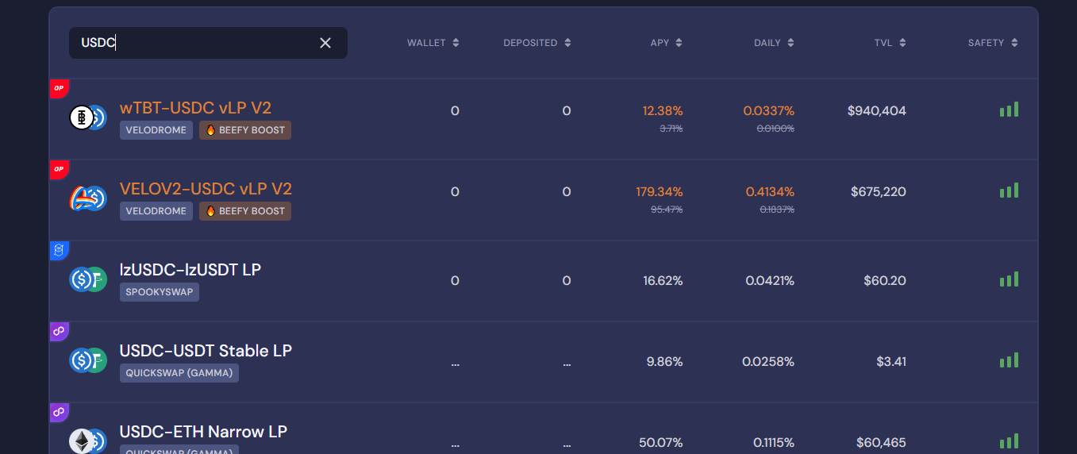
The search results page does not make it clear how many results were retrieved, and if the number of results per page can be configured by the user. The platform also does not effectively rank search results by relevance.

Slide 34
BEEFY FINANCE UX AUDIT REPORT
HELP, FEEDBACK AND ERROR TOLERANCE
These guidelines help assess if the site helps prevent customers from making errors. A site is error-tolerant if, despite evident errors in input, the intended result may be achieved with either no or minimal corrective action by the customer.

Slide 35
Issue (LOW)
Recommendations
The platform does not incorporate progress indicators to keep users informed about ongoing processes or the completion status of tasks. Users may feel uncertain about the progress of their actions, resulting in a lack of confidence and potentially causing them to repeat actions or abandon tasks prematurely
The platform does not provide demonstrations or guided tutorials to showcase how to perform common tasks or utilize key features. Users may face challenges in understanding how to navigate the platform, complete actions, or leverage the available functionalities effectively.
Incorporate progress indicators or step-by-step guides for complex processes or multi-step workflows. This allows users to understand their current position within the process, the remaining steps, and the estimated time for completion.
Develop interactive tutorials or guided tours that walk users through common tasks and demonstrate the platform's functionality. These tutorials should provide step-by-step instructions, highlighting key features and interactions, and allowing users to practice and apply their learnings in real-time.

Slide 36
Issue (LOW)
Recommendations
The platform does not offer informative prompts or messages that educate users about its features, functionalities, or hidden capabilities. Users may miss out on important functionalities, shortcuts, or best practices that could enhance their experience and improve their efficiency
The platform does not prompt users before automatically correcting their erroneous input. Users may not be aware of mistakes in their input, and the platform's failure to provide suggestions or alternatives can result in inaccurate or undesired outcomes
Introduce informative prompts strategically placed throughout the platform to provide helpful tips, suggestions, or feature highlights. These prompts should be context-sensitive and appear at relevant moments to guide users, showcase hidden functionalities, or share best practices.
Introduce error correction prompts that appear when the user's input is potentially incorrect or misspelled. These prompts should provide suggestions or alternatives based on common errors or closely related terms, allowing users to review and correct their input if needed.

Slide 37
BEEFY FINANCE UX AUDIT REPORT
TRANSPARENCY OF DATA PROVENANCE
Does the application clearly indicate which data comes from the blockchain and which does not?
Are the addresses of the contracts clearly stated?
Are all blockchain data linked to independent blockchain explorers?
Is it clear which data comes from oracles?

Slide 38
Issue (LOW)
Recommendations
Beefy does not clearly indicate which data originates from the blockchain and which data does not.
Platform does not provide clear indications regarding the origin of data from oracles
Improve Data Indication: Clearly differentiate between data originating from the blockchain and data from other sources.
Enhance Oracle Data Transparency: Clearly disclose the sources of data obtained from oracles

Slide 39
BEEFY FINANCE UX AUDIT REPORT
TRANSPARENCY OF TRANSACTIONS
Are irreversible actions clearly indicated?
Are actions involving money or value clearly indicated?
Are actions that could potentially lead to user identification clearly indicated?
Are actions that generate new contracts in the user's name clearly indicated?
Does the application clarify and confirm the new future state in advance?
Is the data being used for a transaction shown in a human-readable format?
Are suggested values for gas price clarified and how to overwrite the transaction?
Is transaction wait time managed effectively

Slide 40
Issue (LOW)
Recommendations
This absence of transaction history significantly limits the user's ability to track and review their past activities, hindering transparency and user engagement.
The platform does not provide clear indications of where the user's history is stored, whether it is stored locally on the user's device or on the server. This lack of clarity can lead to user confusion and concerns regarding data privacy, accessibility, and potential data loss
Implement a dedicated section that provides users with a clear and complete transaction history for a given address. This feature will empower users to review and analyze their past activities, fostering transparency and accountability.
Clearly communicate to users whether their history is stored locally on their device or on the server. This can be achieved by providing explanatory text or tooltips that detail the storage location and the implications associated with it, such as data synchronization or potential limitations.

Slide 41
Issue (LOW)
Recommendations
Beefy does not provide users with the necessary tools to navigate, search, export, or delete the history cache. This lack of functionality restricts users from efficiently managing and leveraging their transaction history, impacting usability and user control
Introduce user-friendly tools to navigate, search, export, and delete the history cache. These features will enable users to efficiently access and manipulate their transaction data, enhancing usability and user control.

Slide 42
BEEFY FINANCE UX AUDIT REPORT
TRANSPARENCY OF CODE
Is it clear which blockchain is being used?
Are the addresses of the Smart Contracts used in read/write operations clarified?
Is it clear which code is open source and where to find it?
Is it clear where code is being run (local vs remote server)?
Is the web3 provider / Blockchain node clarified?

Slide 43
Issue (LOW)
Recommendations
The platform does not clearly indicate whether the code is being run locally on the user's device or on a remote server.
The platform does not make it clear which data originates from oracles or has been influenced by oracles.
Clearly communicate whether the code is executed locally or on a remote server, addressing concerns related to data privacy, security, and external dependencies.
Clearly indicate when data is sourced from or influenced by oracles. This transparency will empower users to differentiate between data from different sources.

Slide 44
BEEFY FINANCE UX AUDIT REPORT
PERMANENT NEWBIE MODE
Is educational information woven into normal interaction?
Are there 2 or more levels of educational content: Blockchain basics and Dapp specific lingo?
Is the amount of new things and concepts that the user needs to learn minimized and increased progressively?

Slide 45
Issue (MEDIUM)
Recommendations
The platform does not provide two or more levels of educational content, covering both blockchain basics and Dapp-specific terminology.
The platform does not provide two or more levels of educational content, covering both blockchain basics and Dapp-specific terminology.
Excessive New Concepts: The platform introduces an excessive amount of new things and concepts for users to learn all at once. This approach overwhelms users and creates a steep learning curve, making it difficult for them to grasp and retain the information effectively.
Develop two or more levels of educational content, including blockchain basics and Dapp-specific lingo, to cater to users with varying levels of familiarity.
Develop two or more levels of educational content, including blockchain basics and Dapp-specific lingo, to cater to users with varying levels of familiarity.
Provide contextual help and guidance throughout the platform to assist users as they encounter new concepts or features.

Slide 46
BEEFY FINANCE UX AUDIT REPORT
GAS PRICE AND TRANSACTION REVERSAL
Is what Gas and Gas price clarified?
Are gas prices ranges suggested and time approximations for the upper and lower bounds clarified?
Are transaction reversals allowed?

Slide 47
Issue (SERIOUS)
Recommendations
Gas Price Ranges and Time Approximations: The platform does not suggest gas price ranges or provide time approximations for the upper and lower bounds. This absence of information makes it challenging for users to estimate transaction costs and plan their interactions accordingly. Clear suggestions and time approximations would help users make informed decisions based on factors like network congestion and gas fees.
Transaction Reversals: The platform does not allow for transaction reversals. This limitation can be problematic if users make unintended or erroneous transactions.
Gas Price Ranges and Time Estimates: Suggest gas price ranges and provide time approximations for the upper and lower bounds. This information will assist users in estimating transaction costs and better planning their interactions based on network conditions and gas fees.
Transaction Reversal Mechanism: Introduce a mechanism for transaction reversals, allowing users to undo unintended or erroneous transactions. This feature will enhance user control, reduce anxiety, and provide a safety net for potential mistakes.

Slide 48
BEEFY FINANCE UX AUDIT REPORT
USABILITY SCORE

Slide 49
156/193
GOOD
Users should be able to use this site or system with relative ease and should be able to complete the vast majority of important tasks.
USABILITY SCORE
Ultimately, the usability score is a quantitative or qualitative representation of how usable and effective a product is in meeting user needs and goals. It helps evaluate the success of UX design and identify areas for improvement to enhance the overall user experience.

Slide 50
BEEFY FINANCE UX AUDIT REPORT
NEXT STEPS

Slide 51
NEXT STEPS
Suggestions to improve the Beefy Finance experience
#1
Implement Findings -
Follow up the Implementation of the Research Findings on live platform.

Slide 52
BEEFY FINANCE UX AUDIT REPORT
RESOURCES

Slide 53
SOURCES
Explore attached Unabridged UX audit detailed findings on Beefy Finance
Expert Review Based On web Usability Guidelines Spreadsheet report
Expert review based on Web3 UX Principles by Beltran Spreadsheet report
Expert review collation and usability score report on Airtable spreadsheet Report

Slide 54



www.generalmagic.io

